Slide 1
Trainingsday powerpoint
Welcome, today we’ll get you prepared for ASMUN 2024.
ASSEN MODEL UNITED NATIONS

Slide 2
TO BE EXPLAINED
What is ASMUN?
Rules of procedure
Speeches
Resolutions
ASSEN MODEL UNITED NATIONS

Slide 3
wHAT IS ASMUN?
UN simulation
Representing countries
Debates and resolutions
ASSEN MODEL UNITED NATIONS

Slide 4
Rules of procedure
GENERAL RULES
DEBATE PHASES
RULES GOVERNING
SPEECHES, POINTS, THE PATH TO A RESOLUTION, VOTING
ASSEN MODEL UNITED NATIONS

Slide 5
GENERAL RULES
English is the main language
Formal clothing is mandatory
Chairs have the final say
No electronics except during unmoderated caucuses
Refrain from using personal pronouns
Raise placard when you want to talk
Respect
ASSEN MODEL UNITED NATIONS

Slide 6
DEBATE PHASES
GENERAL SPEAKERS LIST
1
(UN)MODERATED CAUCUS
2
CLOSING THE DEBATE
3
ASSEN MODEL UNITED NATIONS

Slide 7
Rules governing speeches
General speakers list
Taking the floor
Yielding
ASSEN MODEL UNITED NATIONS

Slide 8
Rules governing POINTS
Point of…
Personal privilege
Order
Parliamentary inquiry
ASSEN MODEL UNITED NATIONS

Slide 9
Rules governing THE PATH TO A RESOLUTION
Signatories for draft resolution
Introduction of draft resolution
Introduction of amendments
ASSEN MODEL UNITED NATIONS

Slide 10
Rules governing voting
Procedural voting
Substantive voting
Roll call voting
ASSEN MODEL UNITED NATIONS

Slide 11
SPEECHes
VOICE
POSTURE
HANDS
ASSEN MODEL UNITED NATIONS

Slide 12
HOW TO WRITE A RESOLUTION
FORMAT
PREAMBULATORY AND OPERATIVE CLAUSES
HANDING IN RESOLUTION
VOTING IN RESOLUTION
ASSEN MODEL UNITED NATIONS

Slide 13
A resolution’s FORMAT
General information, such as:
Committee name
Topic of the committee session
Main submitter
Signatories
ASSEN MODEL UNITED NATIONS

Slide 14
AN EXAMPLE OF THE FORMAT
Committee: The United Nations Environmental Programme
Topic: Conservation of biodiversity and protection of endangered species.
Submitted by: France
Signatories: Finland, Italy, The Netherlands, Norway, Ukraine, United Kingdom, United States
ASSEN MODEL UNITED NATIONS

Slide 15
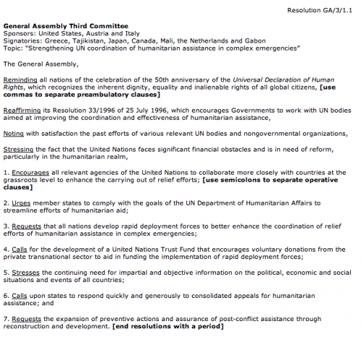
AN EXAMPLE RESOLUTION
This is an example of a resolution.
More examples can be found online.
ASSEN MODEL UNITED NATIONS

Slide 16
PREAMBULATORY CLAUSES
Introduction of the resolution
Describes the issue
Each clause starts with preambulatory phrase
End with , (a comma)
Example: The United Nations Human Rights Council Mindful of the severity of this issue,
ASSEN MODEL UNITED NATIONS

Slide 17
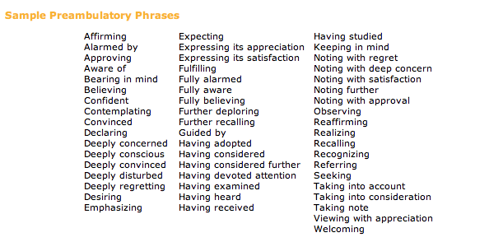
PREAMBULATORY PHRASES
These are preambulatory phrases for your resolution.
Remember to have these in italic.
ASSEN MODEL UNITED NATIONS

Slide 18
OPERATIVE CLAUSES
Describes the solution to the problems
Each clause starts with an underlined operative phrase
End with ; (a semicolon)
Example: Strongly condemns the above noted conditions as unacceptable and improvable;
ASSEN MODEL UNITED NATIONS

Slide 19
OPERATIVE PHRASES
These are operative phrases for your resolution.
Remember to have these underlined.
ASSEN MODEL UNITED NATIONS

Slide 20
amendments
To change or remove something
2 speakers in favour and against
Format:
Name resolution
Main submitter
Signatories
Content of amendment
ASSEN MODEL UNITED NATIONS

Slide 21
An EXAMPLE of an AMENDEMENT
Resolution: 1.1
Main submitter: Croatia
Signatories: Austria, Canada, Denmark, Germany, United States
Changes: In OC 5, replace “complete ban” to “reduction”.
ASSEN MODEL UNITED NATIONS

Slide 22
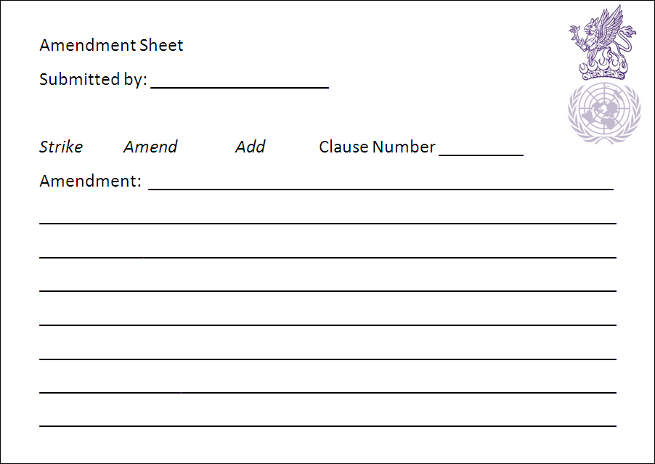
AN AMENDMENT SHEET
This is an example of an amendment sheet we’ll use on which you’ll need to write the correct information.
ASSEN MODEL UNITED NATIONS

