Slide 1

Assen Model
United Nations
Training Day 1

Slide 2
Content
Schedule
What is MUN?
ASMUN
Rules of Procedure
Public speaking

Slide 3

SCHEDULE
09.00 – 09.55 What is (M)UN? Followed by introduction on ASMUN
9.55 – 10.10 Break
10.10 – 11.50 Rules of Procedure
11.50 – 12.30 Break
12.30 – 13.30 Rules of Procedure
13.30 – 14.00 Break
14.00 – 16.00 Public speaking
Questions?

Slide 4
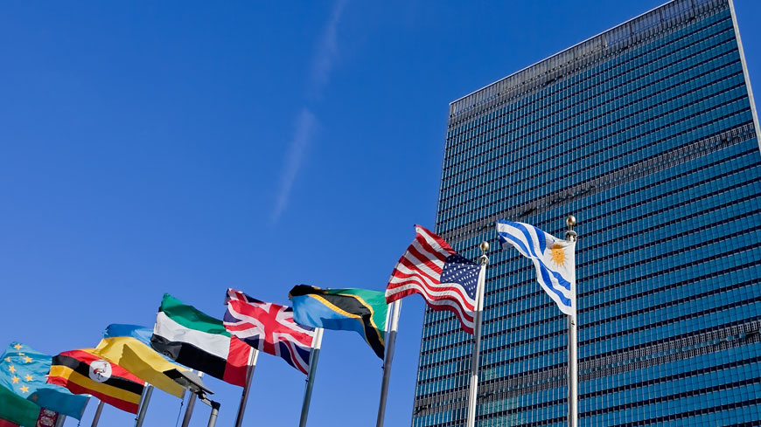
What is the UN?
International organization (formed after WWII)
Purpose: maintaining international peace and security, promote democracy, protect human rights and uphold international law
193 member states, 2 observer states
Committees
SDG’s (Sustainable Development Goals)
Important because it is recognized by a majority of countries

Slide 5
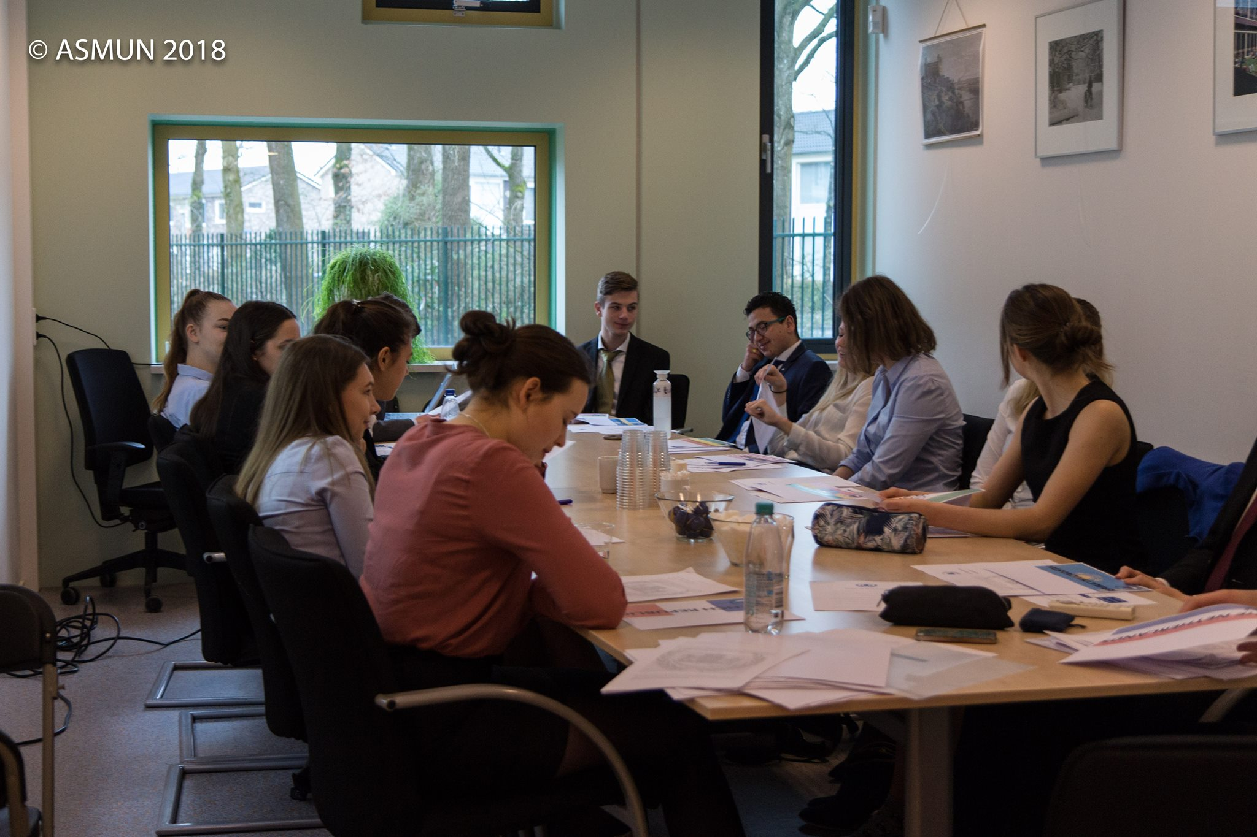
What is MUN?
Model United Nations
Debating
Negotiating
Resolution
Representing member states

Slide 6
Set-up (AS)MUN
Committees ASMUN:
  Security Council (SC)
  United Nations Environment Programme (UNEP)
  Economic and Social Council (ECOSOC)
  Human Rights Council (HRC)
  General Assembly (GA)
Debate
  Questions?

Slide 7
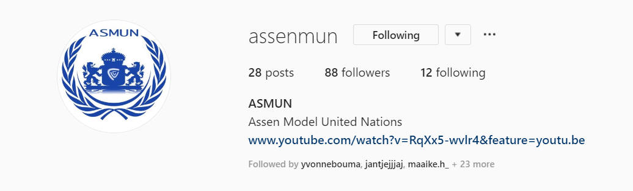
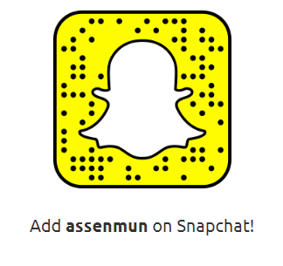
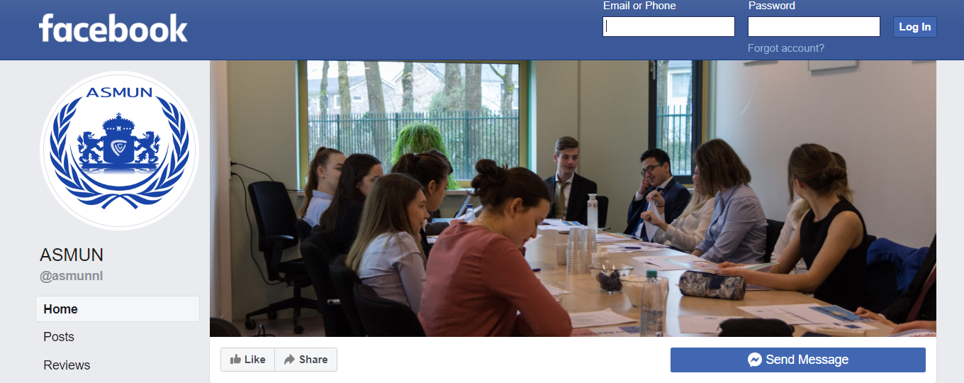
ASMUN
The third ASMUN Conference!
Wednesday, the 29th of January 2019
110 participants
Formal attire is obligated
https://asmun.nl/

Slide 8
ASMUN
Our Future is Now.
“Tomorrow belongs to those who prepare for it today.”

Slide 9
Rules of Procedure
General Speakers’ List (GSL)
Yielding
Points
(Un)moderated Caucus
Motions
Draft resolutions and amendments
Voting
Position Papers
Mini-Mun

Slide 10
Rules of Procedure
Set-up MUN – General Speakers’ List (GSL)
Each country has the right to give an opening speech (obligated in SC)
Explain your country’s policy
Each delegation has 45 seconds (example, determined upon the discretion of the chair(s))
‘’Honourable chair(s), honourable delegates…’’
Always speak on behalf of the country you are representing!
Always send a note that you would like to be re-added on the GSL
Always yield your time

Slide 11
Set-up MUN – Yielding
Only yield on the GSL
Yield to the chair:
  “We would like to yield our remaining time back to the chair”
Yield to questions
  “We would like to yield our remaining time to questions”
Yield to another delegate
  “We would like to yield our remaining time to the delegation of <country>”

Slide 12
Set-up MUN - Points
Point of Personal Privilege – e.g. in case something is barely audible or in case it is too hot/cold in the room.
Point of Parliamentary Inquiry – e.g. in case a delegate would like to ask the Chair or a fellow delegate a question concerning the Rules of Procedure or the content of a delegate’s speech when it is not clear.
Point of Order – e.g. when a delegation feels that there is an error in the parliamentary procedure.

Slide 13
Set-up MUN – Unmoderated Caucus
More informal discussion
Find your allies
Write draft resolutions & amendments
Example:
“The delegate of Italy would like to motion for an unmoderated ……………caucus of ten minutes.”

Slide 14
Set-up MUN – Moderated Caucus
Member states can decide to move the debate to a more specific sub-topic.
The duration of the speech is dependent on the time given.
Correct order: topic – total duration – speaker’s time
For example:
“The delegation of the Russian Federation would like to motion for a moderated caucus on the possibility of sending a peacekeeping force to Burundi, with a total duration of 10 minutes and an individual speaker’s time of 30 seconds.”

Slide 15
Set-up MUN – Motions
(Un)moderated caucus
  “The delegation of (the) <country> would like to motion for a(n) (un)moderated caucus with a total duration of <time> minutes (and an individual speaker’s time of <time> minutes).” (two-third procedural vote)
Closure of debate
  “The delegation of (the) <country> would like to motion for the closure of debate” (two-third procedural vote)
Rol call vote
  “The delegation of (the) <country> would like to motion for a roll call vote“ (two-third procedural vote)

Slide 16
Set-up MUN – Order
Always send note to chairs to be added again!
Unmoderated Caucus
GSL
or:
Motions
General Speakers List
(GSL)
Motions
and voting
(two-third vote)
Moderated
Caucus
Most disruptive goes first with voting:
Unmod above mod
Longer duration above shorter
Longer speaker time over shorter speaker time (Only with Mod)
Order of motion introduction

Slide 17
Set-up MUN – Order exercise
What is the correct order?
Unmod
15 minutes
Mod
10 minutes
45 sec. indivi.
Mod
20 minutes
60 sec. indivi.
Unmod
10 minutes
Unmod
20 minutes
Mod
15 minutes
60 sec. indivi.
1. 3. 2.
2. 1. 3.
Mod
10 minutes
30 sec. indivi.
Mod
25 minutes
30 sec. indivi.
Mod
10 minutes
45 sec. indivi.
3. 1. 2.

Slide 18
Set-up MUN – Draft resolutions
Drafted during unmoderated caucus – bring laptop!
Follows a standard structure
Authorisation by the chairs when signed by 3-8 delegations (decided by the chairs, depending on the size of the committee)
Hand it in on a flash drive. The chair will announce when your resolution is approved
Voting happens after the closure of debate (of which the topic is the resolution)

Slide 19
Set-up MUN - Amendments
Each country has the right to propose an adjustment to a draft resolution.
Follows a standard structure
Each amendment must have 3-5 signatories, depending on the size of the committee. To be determined at the beginning of the conference.
When approved by the chair, the chair appoints two speakers in favour and two against.
After the four speakers, the committee directly moves into subtantive voting procedure
You can only succesfully amend a clause once.

Slide 20
Set-up MUN – Voting
Procedural Voting
  All voting, excluding the final voting on amendments and draft resolutions
  ‘Yes’ or ‘No’, abstentions are not in order
  Observer states can participate in this voting procedure
Substantive Voting
  Amendments and draft resolutions
  ‘Yes’, ‘No’ or ‘Abstain’
  Observer states cannot participate in this voting procedure
Roll Call Voting
  You can motion for this when voting on amendments and draft resolutions
  Chair will call countries in alphabetical order, starting with a randomly selected country
  ‘Yes’, ‘No’, ‘Abstain’ or ‘Pass’ (Passing is only in order in the first round)
  Every delegate will stand up and state the full name of his/her delegation and its vote
Notes:
When a delegate says ‘Pass’ in the first round of the Roll Call Voting, the chair will mention the delegation again in the second round, and in that round, the delegate will have to give his/her final vote.

Slide 21
Set-up MUN – Position Papers
A small document (1 A4) which explains the following:
  Information about your country & how the issue of the committee session impacts your country
  What your country has already done to solve the issues
  Proposals on what your country would like to do to solve the issue.
Follows a standard structure (examples can be found on www.asmun.nl)
Everybody is required to write one and hand it over to the chairs at the start of the committee session

Slide 22
Keep in mind:
Only the Security Council can send a peacekeeping force.
Note-passing during the conference is allowed
  Communicate with your (potential) allies
  Always ask the Chair to be added to the General Speaker’s List
  Begin your speeches with “Honorable chair, distingushed delegates,”
Gossip Box!
Note-passing is not allowed when:
Voting procedure
Reading of the resolution

Slide 23
Mini-Mun
Scenario: The World is on the brink of World War Three because of a massive zombie outbreak. The United Nations is being pressured to find a solution, and quick! You, as a member of the United Nations, are meant to represent a (fictional) country up to your choice and negotiate with others for a possible solution. Made-up statistics and fictional data is all allowed here. The main point is that you get how the rules of procedure for a MUN works.
Some known data:
There are over a billion people infected.
All those infected live in third world countries.
There has been NO action taken so far; borders are still open for example and no helping aid has been sent.
The source is not clear, however there are speculations that the source leads back to failed medicine experiments done by Western countries.

Slide 24
RULES OF PROCEDURE
Questions?

Slide 25
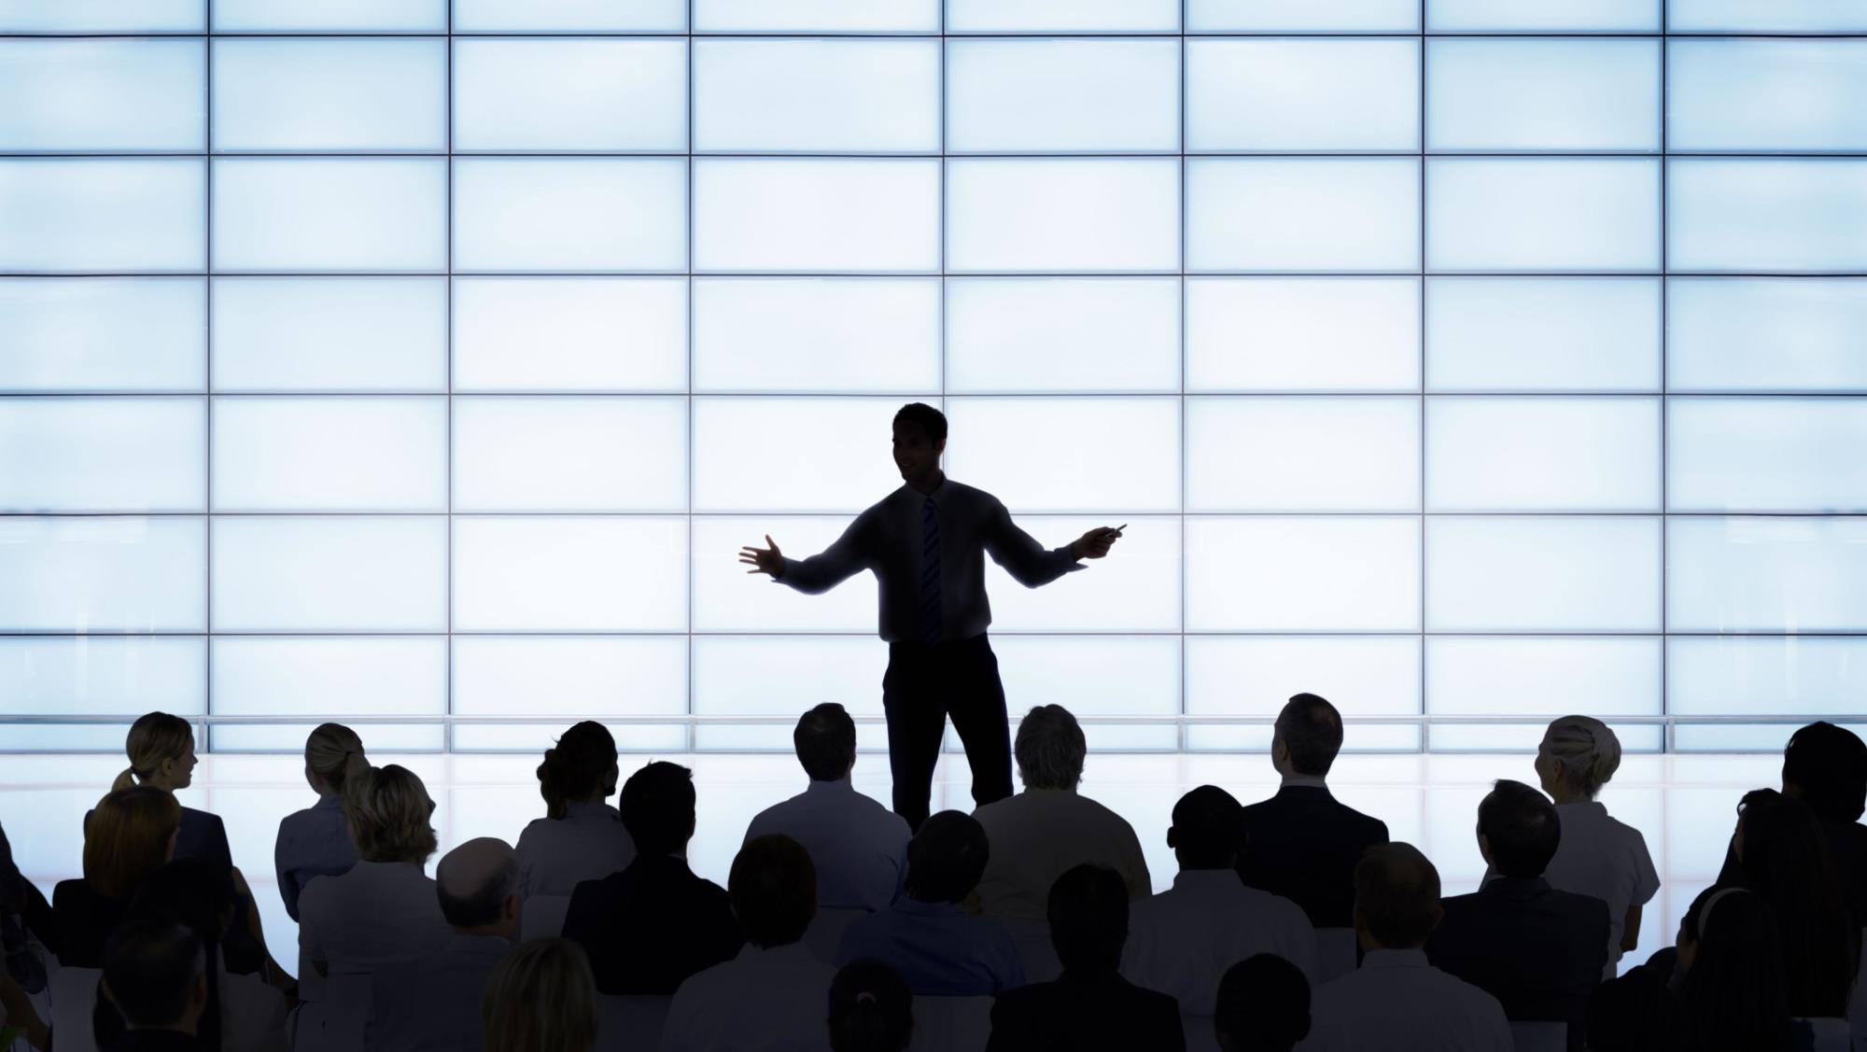
Public Speaking
Content
Techniques
Use of voice
Body language
Speech structure for MUNs
Speech exercises!

Slide 26
Public Speaking
Content
Facts…but not too many
Structure your speech
Address your audience
Keep it relevant
If applicable: throw in a joke
Charlie Chaplin speech: https://www.youtube.com/watch?v=uAd1WJ9gXo0

Slide 27
Public Speaking
Techniques
Contrasts: e.g. peace v.s. war
Addressing Audience: “We” / “You and I”
Call to action: “Must”, “should”
Grand words: “Humanity”, “solidarity”, “peace”, “well-being of our nation” etc. etc.
Repetition: “I have a dream…” (Martin Luther King Jr.)
Hook: “We, the people…” (Obama)
Rhetorical question: “Can you imagine that?”

Slide 28
Public Speaking
Use of Voice
Don’t yell, but don’t mumble either
Articulate clearly
Watch out for monotone voice
Pauses v.s. filler words (“uh, uhm”)
How to NOT use your voice: https://youtu.be/IPIvwu-573Y (2:30)
How to use your voice: https://www.youtube.com/watch?v=QPQ2vZ-JvfU

Slide 29
Public Speaking
The ‘uh/uhm’ exercise

Slide 30
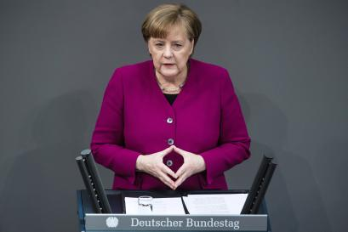
Public Speaking
Body Language
Eye contact!
Hand gestures (e.g. counting)
Don’t dance (wiggling/switching legs)
Have a “default stance”
      The “Merkel”
      The “Holding water”
      The “Hamster”
      The “Casual”
      The “Interrogation”
      Presentation above content: https://www.youtube.com/watch?v=8S0FDjFBj8o
The “Merkel”

Slide 31
Public Speaking
Speech structure for MUNs
  ‘’Honourable chair(s), honourable delegates..’’
  Speak on behalf of your country!
  ‘’We would like to yield our time back to the chair.’’

Slide 32
Public Speaking
Speech exercise!
The Bunker Scenario
  There is a terrible zombie apocalypse! There is a bunker available, but it has limited capacity… The goal is to prove yourself to the group and convince them that you absolutely must get into the bunker.
  20 minutes preparation time
  1 – 2 minute speech

Slide 33
Thank you for listening!
Any questions?

